Slide 1

Driving Growth Through
Digital Investment
June 2021

Slide 2
Agenda
01
EXECUTIVE SUMMARY
05
SEM RATIONALE
02
PERFORMANCE IMPROVEMENT
06
SEO INVESTMENT
03
CURRENT METRICS
07
TIMELINE & IMPACT
04
MARKETING FUNNEL
08
APPENDIX

Slide 3
Executive Summary
Current paid marketing efforts are limiting growth as established budgets are restricting efforts to capture demand.
New metrics established and verified through the winter and spring seasons reflect a dramatic improvement in ROAS and acquisition costs. We need to establish a target ROAS that fosters growth without negatively impacting profit/loss targets.
The balance of paid to organic leads has been heavily skewed towards paid (83% in October 2020). Recent efforts to improve organic/SEO traffic is showing results (78% in May). We need to continue and expand our investment in content creation to continue the momentum to balance between paid and organic.
Request 1: Access to an unlimited budget for SEM efforts so long as Marketing can maintain a minimum ROAS of 2.1 over a 30-day period as measured weekly.
Request 2: Increase the content budget for this fiscal by $64,200 to provide for additional whitepapers, authoritative articles, checklists, and guides to drive organic results in time for the 2022 exterior season.

Slide 4
Performance Improvement
ROAS for SEM was 1.45 when first measured in October. Marketing undertook efforts to clean up the account, focus on converting keywords, and eliminate or dramatically reduce bid-cost for top of the funnel keywords. Our most recent report indicates ROAS has improved to 3.3 (see page 5).
Paid social efforts are not a cost-effective acquisition tool (0.3 ROAS). Paid social will only be used to boost new and seasonal content (whitepapers, guides, articles, etc.).
Qualification rate has dramatically improved through Google and Bing account clean-up (39.7% in May versus 28.4% in October).
Win rate has improved through Sales’ efforts on seasonal verticals and faster response times. The new lead API is delivering leads to the Account Managers and Advisors in 90 seconds (versus 7 minutes through MailGun).
We are now tracking over 650 keywords in French and English combined. Keywords in the top 1-3 positions has increased 27% in French and 18% in English since December.

Slide 5
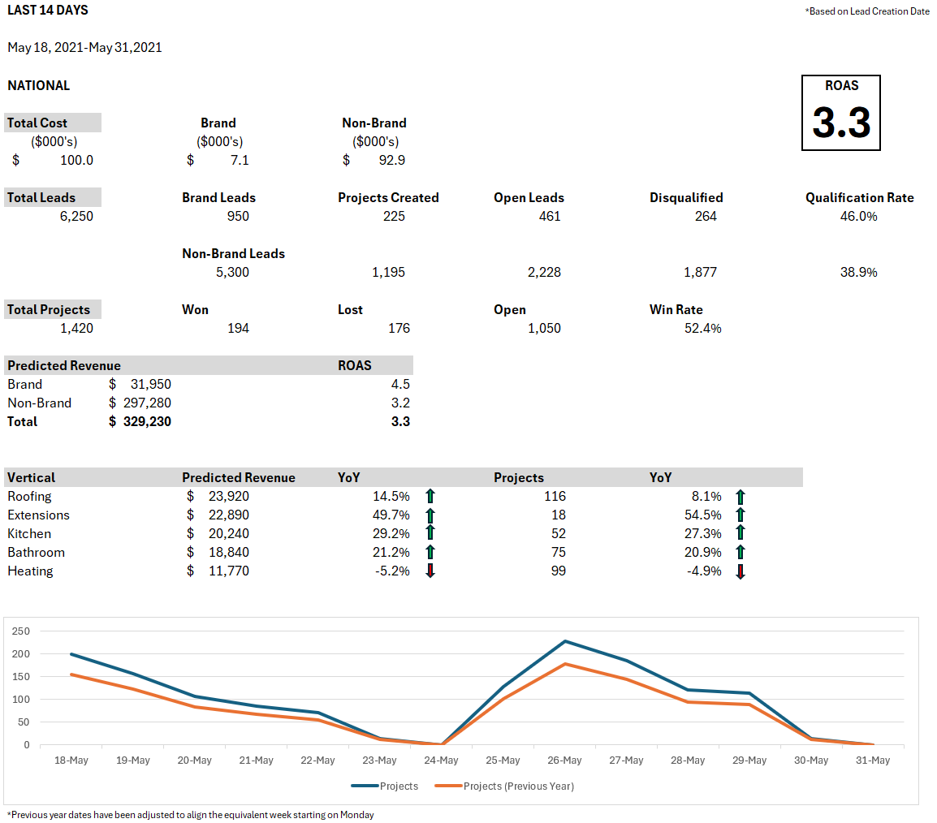
Metrics & Reporting - SEM
Last 14 Days

Slide 6
Metrics & Reporting - Organic
Last 30 Days
Organic
Organic Traffic Referring Domains Backlinks
Top 3 Positions Position 4-10 Position 11-50
Search Visibility Featured Snippets
23,599
5,700
150.8k
102
210
338
UP ✔
DOWN
UP ✔
DOWN
UP
DOWN ✔
3.11%
187
UP ✔
DOWN
UP ✔
DOWN

Slide 7

Metrics & Reporting – Social Media
Last 14 Days
Facebook
Also available: Previous 30 Days, Previous 90 Days, Year to Date
Also available: Twitter
Social
Impressions Followers (FR) Followers (EN)
Engagement Rate Shares Page Views
Paid Impressions Conversion Rate COA
Like to Dislike Ratio
47,535
17%
3%
17,292
2,432
2%
23%
5%
3%
1.73%
2,102
12,953
0
N/A
N/A
100%
100%
93/7

Slide 8

Marketing Funnel
This is a simplified version of the kitchen funnel. It illustrates the SEO effort is focused on top of the funnel keywords while covering the full funnel. SEM is focused almost entirely on bottom of the funnel keywords that convert to leads.
Keyword Groups | Keywords | SEM Effort | SEO Effort
TOFU | Kitchen costs Kitchen trends Kitchen ideas | 5% | 60%
MOFU | Counter costs, trends, ideas Backsplash costs, trends, ideas Kitchen flooring costs, trends, ideas Tips & Tricks | 5% | 10%
BOFU | Best kitchen contractor How to find a kitchen contractor Questions to ask a contractor Tips & Tricks | 90% | 30%
3-18 Months Decision Process
AWARENESS
CONSIDERATION
INTENT

Slide 9

SEM Rationale
We began measuring the return on investment for our SEM efforts last October using existing data. In December, we built a predictive model based on the historical qualification rate and win rate by vertical. Finance, Sales, and Marketing agreed the predictive model was ≈95% accurate in March and has been our standard since that time. We continue to review its accuracy quarterly with Finance.
Our ROAS in October was 1.45. At that time, we began to clean up the Google and Bing accounts focusing on converting keywords. By February, our ROAS was over 3.0 and has remained there, going as high as 4.2 in early April.
Our SEM efforts were limited by budget in Google across many verticals in the spring – particularly high-volume B2B and B2C exterior verticals (roofing, drainage, HVAC) leaving projects for other companies to win. While we moved budget from social & Q3/Q4 and changed the allocation by vertical, we were not fully able to capture demand.
Marketing believes the company could invest an extra $750k or more in Q3/Q4 and maintain the ROAS above 2.5. We are analyzing the potential for 2022 and will include a recommendation in the 2022 Strategic Plan.

Slide 10

SEO Investment
We engaged PH+ Digital to conduct a thorough SEO audit in November, with the goal of:
Identifying converting and brand-building keywords
Building a competitive analysis
Cleaning up negative backlinks
Reviewing old articles for metadata, descriptions, images, etc.
Building link-worthy content partnerships
We began investing in SEO in January with a limited budget for creation of articles and guides for both B2B and B2C. We need to dramatically increase our production of whitepapers (B2B), guides, authoritative articles, and checklists to compete with Soumission Rénovation and Homestars.
We need to create enough material to build effective email automation workflows in 2022 to engage potential customers and pull them through the funnel.
We are requesting an additional $64,200 for this fiscal to create 6 authoritative articles, 2 guides, 2 whitepapers, and 3 checklists for exterior renovation projects. It is necessary to create these material 3 months before the exterior season starts to be recognized by the Google algorithm.

Slide 11

Timeline & Impact
SEM
Investment Across Exterior Verticals
Investment Across Interior and Construction Verticals
Content Initiatives
New Content Production
Roll-out of New Articles
Measurement and Optimization of Content Initiatives
Technical SEO
Ongoing Review and Changes
Measuring Impact of Technical SEO Changes
September
October
November
December
January
February
March

Slide 12
+
Appendix
Search Visibility (French)
Search Visibility (English)
SEO Tracking

Slide 13
Search Visibility (French)
 | RénoAssistance | Soumission Rénovation | Eco Habitation | Soumission Maison | Construction Rénovation | Clic Soumission | La Rénovation
Domain Authority | 23 | 32 | 48 | 18 | 18 | 20 | 27
Referring Domains | 1,000 | 620 | 1,460 | 230 | 330 | 275 | 285
Indexed Pages | 2,100 | 47,600 | 24,000 | 1,100 | 1,200 | 4,500 | 410
Keywords Ranking | 17,000 | 56,000 | 60,000 | 11,000 | 7,000 | 7,000 | 19,000
Estimated Traffic | 24,000 | 92,000 | 70,000 | 7,000 | 6,000 | 4,000 | 12,000
Estimated Traffic Value | $86k | $148k | $58k | $13k | $12k | $7k | $7k
*combined French and English
Source: Moz, ahrefs, Google – October 2020

Slide 14
Search Visibility (English)
 | RenoAssistance | Porch | HomeAdvisor | Thumbtack | Homestars | Trusted Pros
Domain Authority | 23 | 32 | 48 | 18 | 18 | 20
Referring Domains | 1,000 | 620 | 1,460 | 230 | 330 | 275
Indexed Pages | 2,100 | 47,600 | 24,000 | 1,100 | 1,200 | 4,500
Keywords Ranking | 27,000 | 56,000 | 60,000 | 11,000 | 7,000 | 7,000
Estimated Traffic | 35,000 | 92,000 | 70,000 | 7,000 | 6,000 | 4,000
Estimated Traffic Value | $86k* | $148k | $58k | $13k | $12k | $7k
*combined French and English
Source: Moz, ahrefs, Google – October 2020

Slide 15
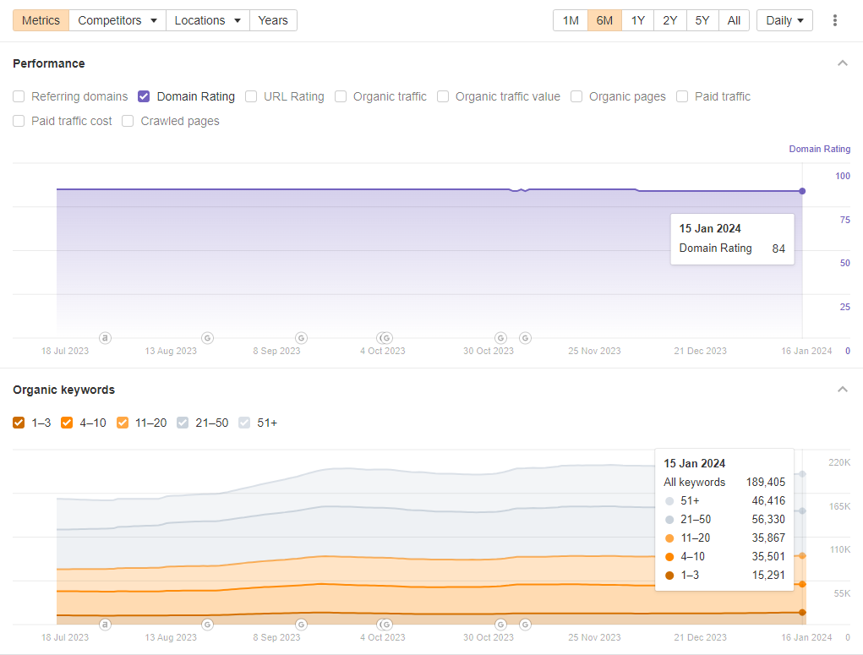
SEO Tracking
Source: Semrush

